Slide 1
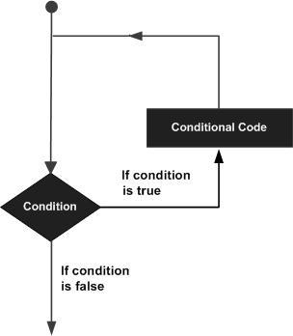
Loops
A loop statement allows us to execute a statement or group of statements multiple times

Slide 2
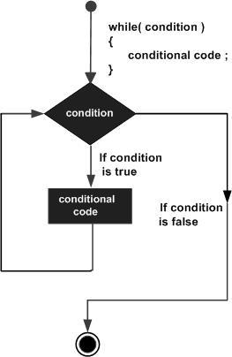
while
A while loop statement is repeatedly executes a target statement as long as a given condition is true.
Syntax
while(condition)
{
statement(s);
}

Slide 3
Program
#include <stdio.h>
int main ()
{
/* local variable definition */
int a = 10;
/* while loop execution */
while( a < 20 )
{
printf("value of a: %d\n", a);
a++;
}
return 0;
}

Slide 4
for loop
for loop is a repetition control structure that allows you to efficiently write a loop that needs to execute a specific number of times.
Syntax
for ( init; condition; increment )
{
statement(s);
}

Slide 5
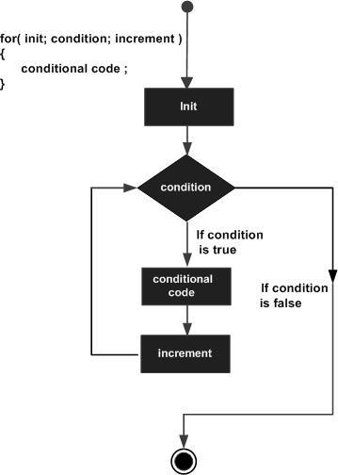
1. The init step is executed first, and only once.
2. Next, the condition is evaluated.
3. After the body of the for loop executes, the flow of control jumps back up to the increment statement.

Slide 6
Program
#include <stdio.h>
int main ()
{
int a;
/* for loop execution */
For(a = 10; a < 20; a = a + 1 )
{
printf("value of a: %d\n", a);
}
return 0;
}

Slide 7
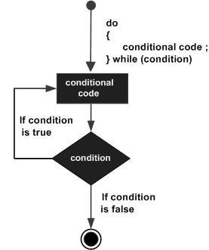
do...while
do...while loop is similar to a while loop, except that a do...while loop is guaranteed to execute at least one time.
Syntax
do
{
statement(s);
}while( condition );
If the condition is true, the flow of control jumps back up to do, and the statement(s) in the loop execute again.
This process repeats until the given condition becomes false.

Slide 8
Program
#include <stdio.h>
int main ()
{
/* local variable definition */
int a = 10;
/* do loop execution */
do
{
printf("value of a: %d\n", a);
a = a + 1;
}while( a < 20 );
return 0;
}

Slide 9
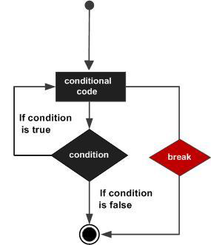
break statement
The break statement is encountered inside a loop, the loop is immediately terminated and program control resumes at the next statement following the loop.
It can be used to terminate a case in the switch statement.
Syntax
break;

Slide 10
Program
#include <stdio.h>
int main ()
{
/* local variable definition */
int a = 10;
/* while loop execution */
while( a < 20 )
{
printf("value of a: %d\n", a);
a++;
if( a > 15)
{
/* terminate the loop using break statement */
break;
}
}
return 0;
}

Slide 11
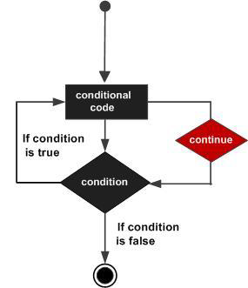
continue statement
For the for loop, continue statement causes the conditional test and increment portions of the loop to execute.
For the while and do...while loops, continue statement causes the program control passes to the conditional tests.
Syntax
continue;

Slide 12
Program
#include <stdio.h>
int main ()
{
/* local variable definition */
int a = 10;
/* do loop execution */
do
{
if( a == 15)
{
/* skip the iteration */
a = a + 1;
continue;
}
printf("value of a: %d\n", a);
a++;
}while( a < 20 );
return 0;
}

Slide 13
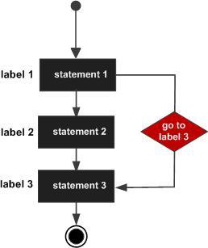
goto statement
A goto statement provides an unconditional jump from the goto to a labeled statement in the same function.
Syntax
goto label;
..
..
label: statement;

Slide 14
Program
#include <stdio.h>
int main ()
{
/* local variable definition */
int a = 10;
/* do loop execution */
LOOP:do
{
if( a == 15)
{
/* skip the iteration */
a = a + 1;
goto LOOP;
}
printf("value of a: %d\n", a);
a++;
}while( a < 20 );
return 0;
}

Slide 15
The Infinite Loop
A loop becomes infinite loop if a condition never becomes false.
The for loop is traditionally used for this purpose.

Slide 16
Program
#include <stdio.h>
int main ()
{
for( ; ; )
{
printf("This loop will run forever.\n");
}
return 0;
}

